Slide 1
Research Progress & Updates
By: Daniel Leskiewicz

Slide 2
Project Topic
Exploring approaches on predicting TF-DNA motifs binding pairs.

Slide 3
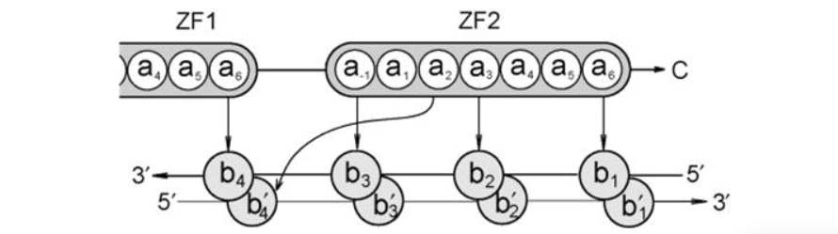

Learning the ‘canonical’ Model
The Structural Model
The Pattern
Notes:
Notes:
The Structure Model : So there are studies that suggest that this ’canonical model’ interface can help with prediction of the DNA-binding preferences of computational approaches. The way that the canonical model interacts is that each finger (Zinc finger) contacts DNA in a antiparallel (it parallel but not in a straight line necessarily) manner. So basically, from this we can visualize each Zinc finger fits into a spot onto the DNA, and these fingers contact four base pairs within the DNA. Within this first paper, the authors mentioned/identified 4 amino acid positions that contact DNA. These positions are referenced to the start of the DNA strand while one of the positions contact the complementary DNA strand.
The Pattern: The authors used this pattern to identify zinc finger proteins. This pattern was really inconsistent with the data that we received from them. The pattern either wasn’t fully consistent with some of the zinc finger samples or didn’t really apply to the protein at all.
- This pattern was used to get the correct positioning of the amino acids into the -1,2,3 and 6 positions

Slide 4
Technical Aspects Of The Paper
Database
Gathering Samples
SVM’s
Linear Kernel
Polynomial Kernel
Notes:
Discuss about how they gathered their data and how they used the Pattern discussed on the previous slide to get proper Zinc Finger Samples
Discuss their SVM approach

Slide 5
The K-mers Approach
Utilization of sklearn models with the kmer approach
Using kmers to see what best value of K gives us the best accuracy
These k-mers are more so describing binding sites and we can cover a discrete space of all possible DNA molecules of length k

Slide 6
Models Implemented with Kmers
Logistic Regression
Random Forrest
MLP (Multi Layer Perceptron)

Slide 7
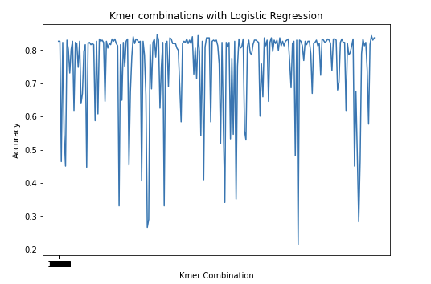
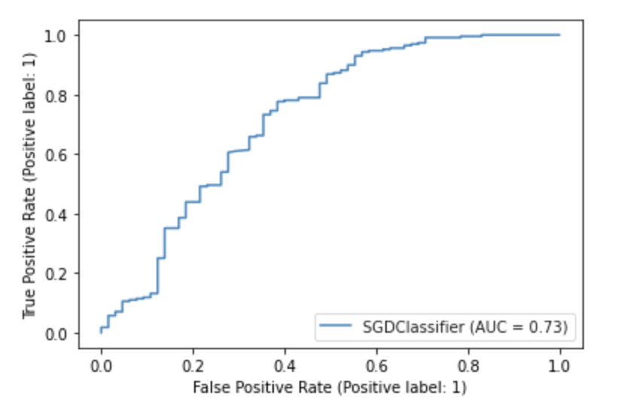
Results From Logistic Regression
AUC Score: 0.6373819163292846
Kmer Combinations : Dna: 1, Zinc:1, Dna:1 Zinc:2, Dna:1 Zinc:3…..DNA:15 Zinc:15
Notes:
Reasons for using logistic Regression. Why is the linear kernel not as good (answer this question when you are presenting)
ROC curve is the measurement for the classification problems at various threshold settings, ROC is a probability curve
AUC represents the degree or measure of separability. It tells how much model can distinguish between the classes. Higher the AUC, better the model is at predicting 0s as 0s and 1s as 1s.

Slide 8
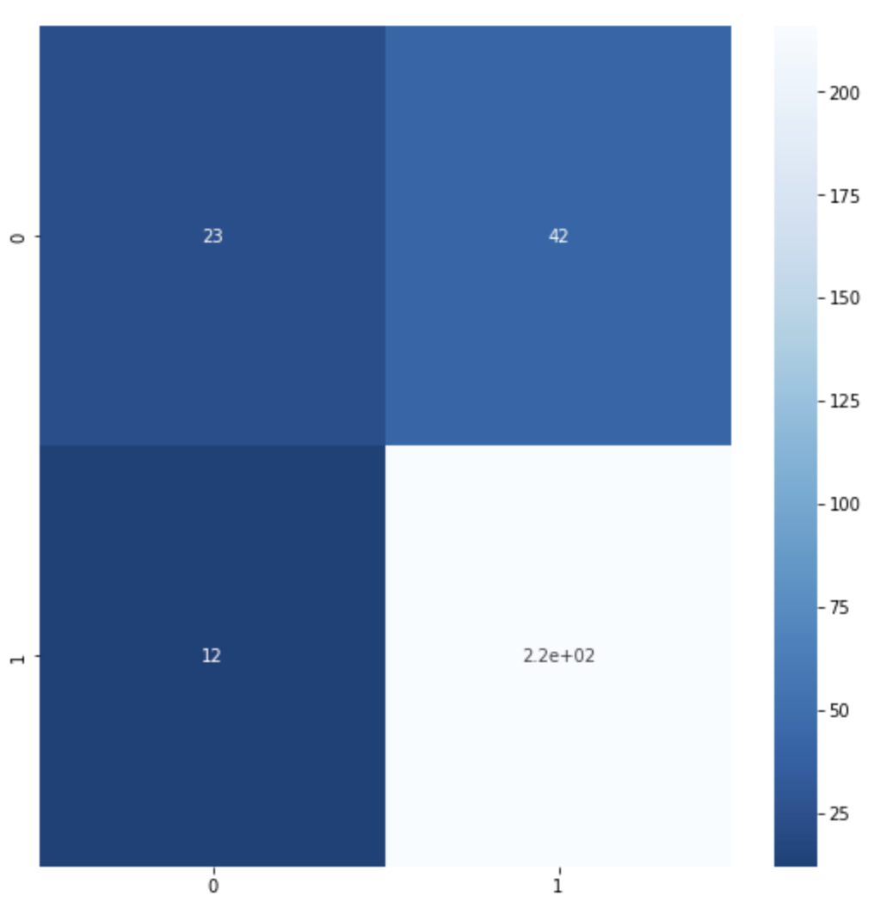
Results From Logistic Regression

Slide 9
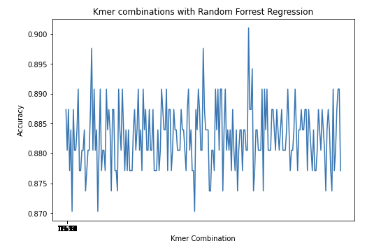
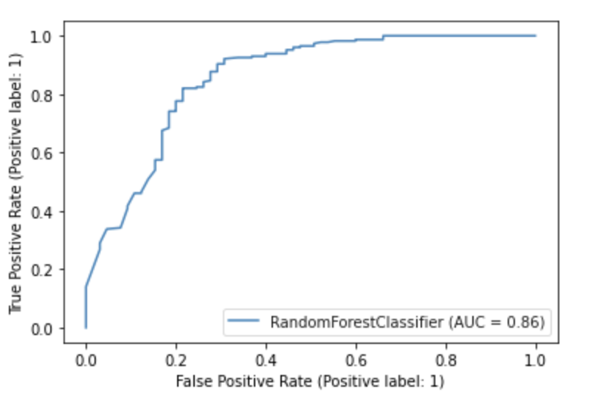
Results From Random Forest Classifier
AUC Score: 0.7418016194331983
Kmer Combinations : Dna: 1, Zinc:1, Dna:1 Zinc:2, Dna:1 Zinc:3…..DNA:15 Zinc:15
Notes:
Explain the benefit of Random Forest and why its better then logistic Regression

Slide 10
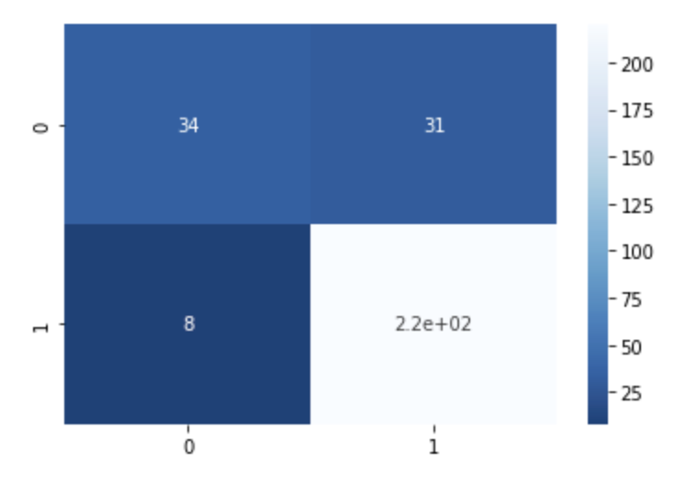
Results From Random Forest Classifier

Slide 11
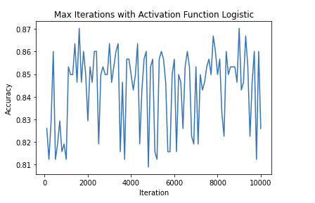
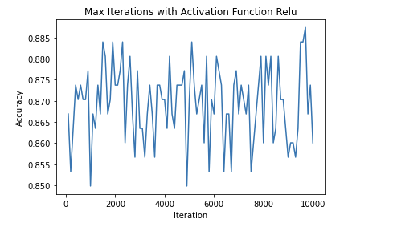
Results From MLP
Activation Function=‘relu’, solver=‘adam’, alpha=0.0001
Activation Function=‘logistic’, solver=‘adam’, alpha=0.0001
Notes:
Explain benefits of MLP and why it could be better

Slide 12
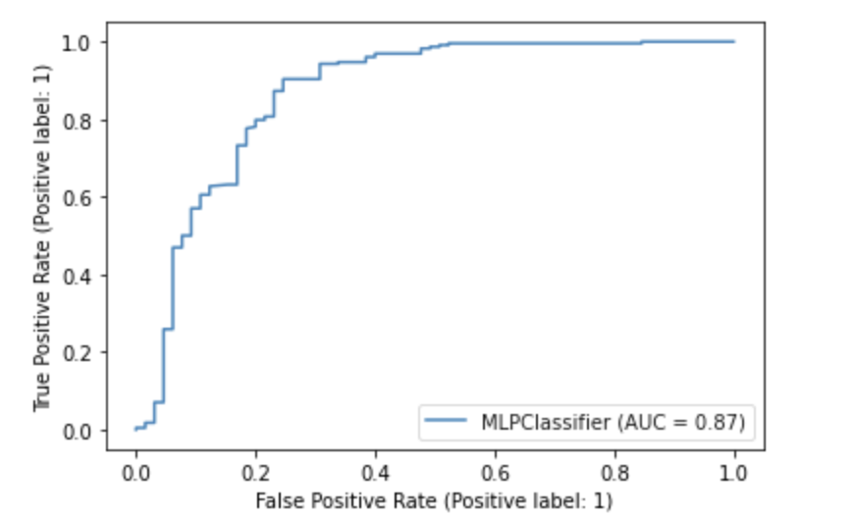
Results From MLP
AUC Score: 0.7835695006747638

Slide 13
Main Progress within the Winter Term
Reading and summarizing different papers at the beginning of the term
Trying to learn the biology required to understand the paper(s)
Last few weeks I was trying to implement and organize the database that was provided within the paper

